Slide 1
Banking Application Capstone Presentation
Will Wright

Slide 2
Part 1: App Diagram, Front-End Architecture, UI Design Choices, & Authentication

Slide 3
Application Overview Diagram
dal.js
MongoDB connection & CRUD functions
index.js
Express servers / middleware
index.html

Slide 4
Application Overview Diagram
dal.js
MongoDB connection & CRUD functions
index.js
Express servers / middleware
index.html
“public”
context.js
alldata.js
withdraw.js
createaccount.js
testimonials.js
deposit.js
navbar.js
home.js
login.js

Slide 5
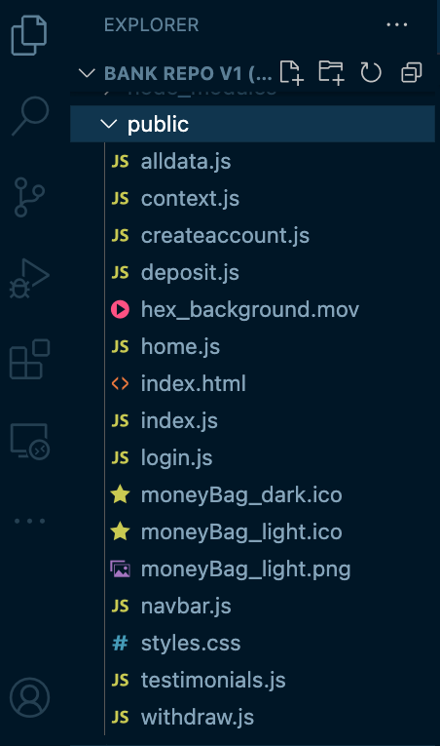
Front-End Architecture
Contains code for rendering user’s banking data

Slide 6
Front-End Architecture
Provides a custom, reusable Card component used elsewhere in the application

Slide 7
Front-End Architecture
Background animation for the app

Slide 8
Front-End Architecture
Contains conditional rendering based on if the user is logged in or not

Slide 9
Front-End Architecture
Contains <div id=“root”></div>

Slide 10
Front-End Architecture
Contains “Spa” component that is rendered inside of the root <div>

Slide 11
Front-End Architecture
Conditionally renders, like the home page, to show different features to a user logged in vs. not logged in

Slide 12
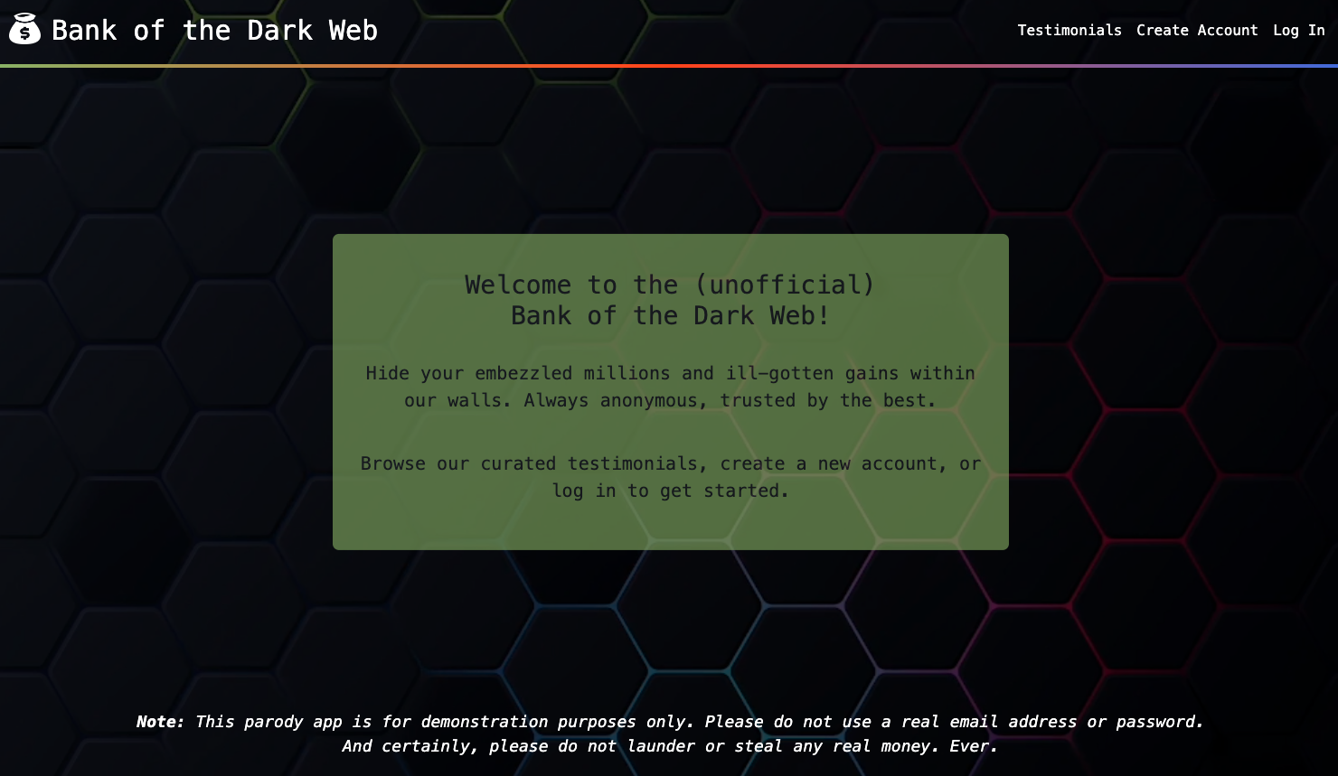
UI Design Choices – Initial Load

Slide 13
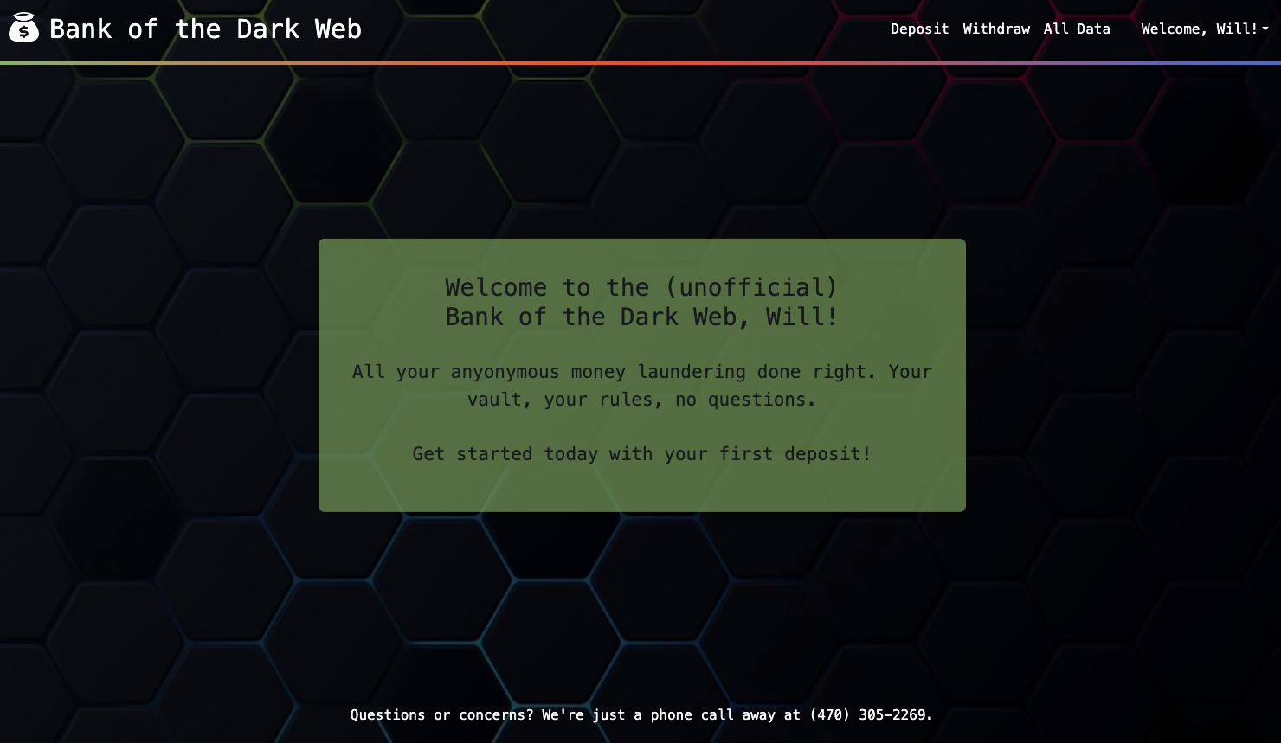
UI Design Choices – Upon Authenticating

Slide 14
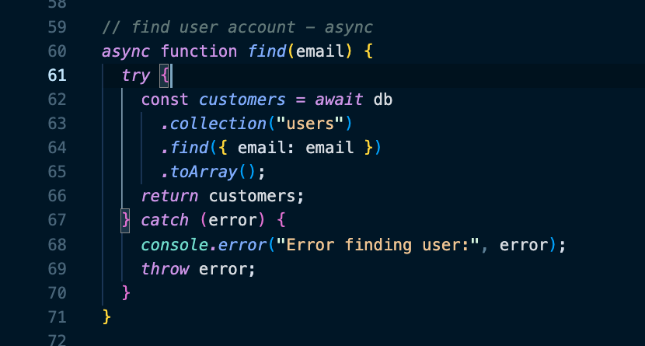
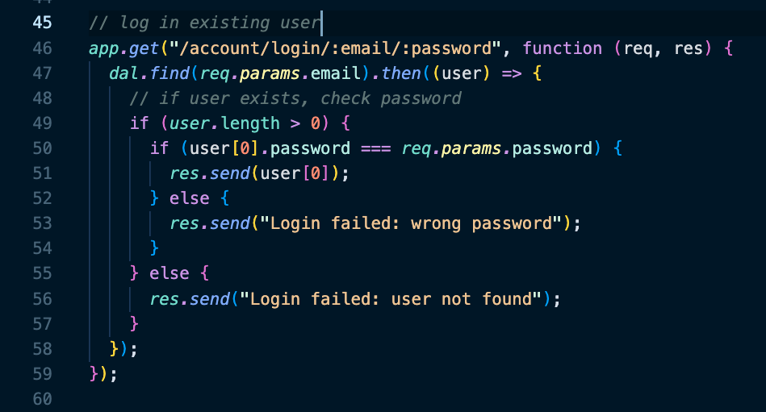
Authentication
dal.js
index.js

Slide 15
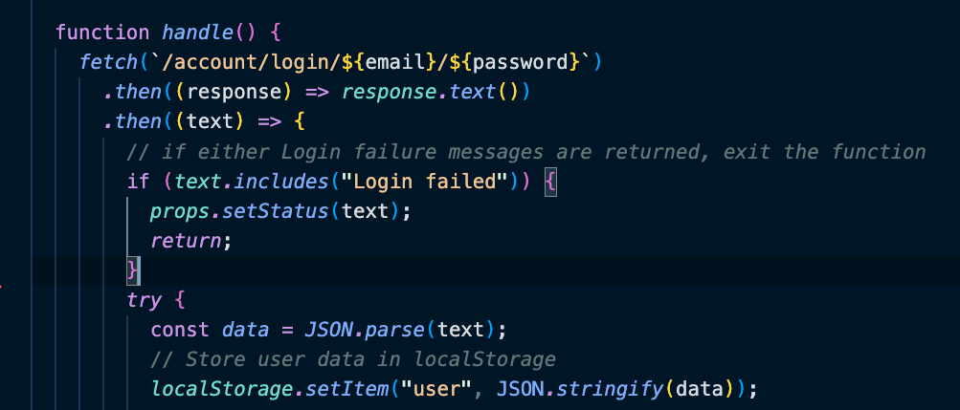
Authentication

Slide 16
Authentication - Challenges
Could not get the “login” route handler to connect to MongoDB
Used Postman to troubleshoot the API routes and get them working exactly as expected
Was unsure how the `localStorage.setItem` functionality worked until I started experimenting and seeing how Local storage within “Application” worked

Slide 17
Part 2: Database And API

Slide 18
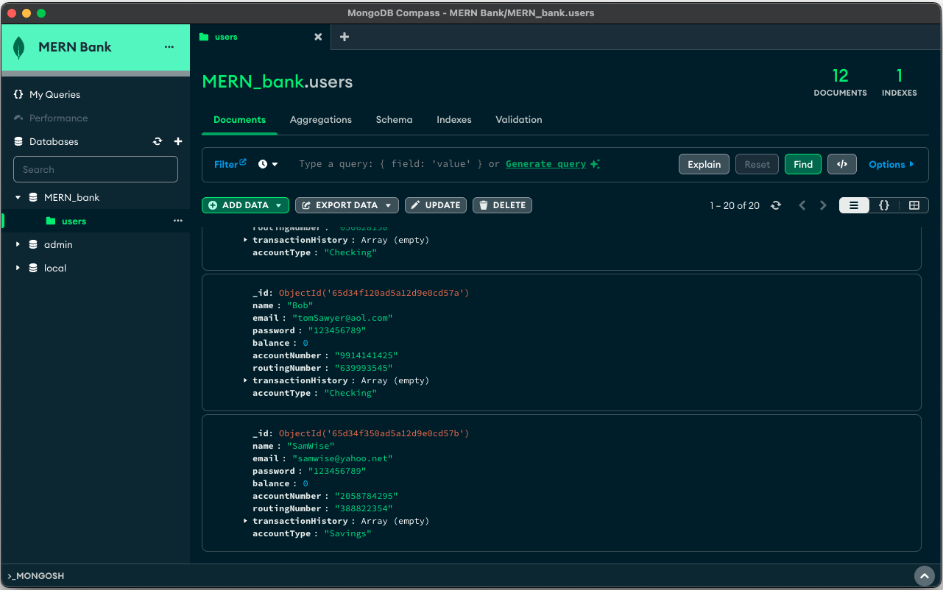
Database - MongoDB

Slide 19
Database - MongoDB
Fields captured in MongoDB:
_id (auto generated by MongoDB)

Slide 20
Database - MongoDB
Fields captured in MongoDB:
_id (auto generated by MongoDB)
Name (as inputted by user)

Slide 21
Database - MongoDB
Fields captured in MongoDB:
_id (auto generated by MongoDB)
Name (as inputted by user)
Email (as inputted by user)

Slide 22
Database - MongoDB
Fields captured in MongoDB:
_id (auto generated by MongoDB)
Name (as inputted by user)
Email (as inputted by user)
Password (as inputted by user)

Slide 23
Database - MongoDB
Fields captured in MongoDB:
_id (auto generated by MongoDB)
Name (as inputted by user)
Email (as inputted by user)
Password (as inputted by user)
Balance (numeric value that begins with 0)

Slide 24
Database - MongoDB
Fields captured in MongoDB:
_id (auto generated by MongoDB)
Name (as inputted by user)
Email (as inputted by user)
Password (as inputted by user)
Balance (numeric value that begins with 0)
accountNumber (randomly generated 10-digit)

Slide 25
Database - MongoDB
Fields captured in MongoDB:
_id (auto generated by MongoDB)
Name (as inputted by user)
Email (as inputted by user)
Password (as inputted by user)
Balance (numeric value that begins with 0)
accountNumber (randomly generated 10-digit)
routingNumber (randomly generated 9-digit)

Slide 26
Database - MongoDB
Fields captured in MongoDB:
_id (auto generated by MongoDB)
Name (as inputted by user)
Email (as inputted by user)
Password (as inputted by user)
Balance (numeric value that begins with 0)
accountNumber (randomly generated 10-digit)
routingNumber (randomly generated 9-digit)
transactionHistory (instantiated as empty array)

Slide 27
Database - MongoDB
Fields captured in MongoDB:
_id (auto generated by MongoDB)
Name (as inputted by user)
Email (as inputted by user)
Password (as inputted by user)
Balance (numeric value that begins with 0)
accountNumber (randomly generated 10-digit)
routingNumber (randomly generated 9-digit)
transactionHistory (instantiated as empty array)
accountType (as selected by user)

Slide 28
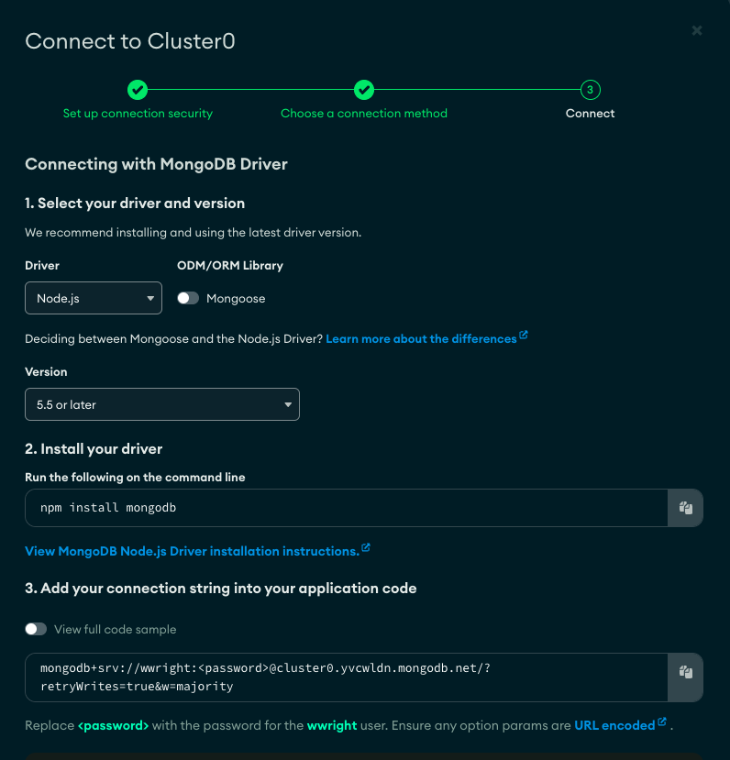
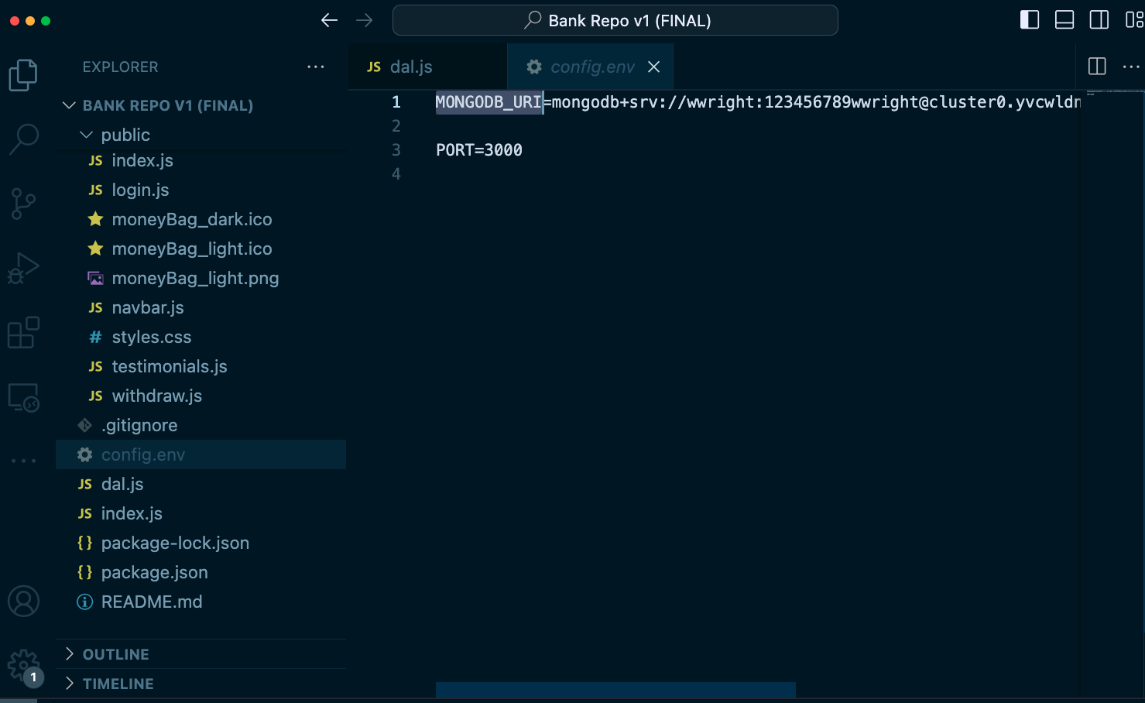
Database Connection - URI

Slide 29
Data Abstraction Layer (dal.js)
Includes:
RESTful async connection to MongoDB using hidden `config.env` file

Slide 30
Data Abstraction Layer (dal.js)
Includes:
RESTful async connection to MongoDB using hidden `config.env` file
Functions to randomly generate each user’s banking account & routing numbers

Slide 31
Data Abstraction Layer (dal.js)
Includes:
RESTful async connection to MongoDB using hidden `config.env` file
Functions to randomly generate each user’s banking account & routing numbers
Async functions to create, find user, login, check for existing email in database, and update a user’s balance based on deposits / withdraws

Slide 32
Data Abstraction Layer (dal.js)
Includes:
RESTful async connection to MongoDB using hidden `config.env` file
Functions to randomly generate each user’s banking account & routing numbers
Async functions to create, find user, login, check for existing email in database, and update a user’s balance based on deposits / withdraws
`Module.exports` to export these functions and read them into the main `index.js` file, also saved in the root of the directory

Slide 33
API Endpoints
Example endpoints used in `index.js` file:
App.get(“/account/create/:name/:email/:password/:accountType”)
App.get("/account/find/:email”)
App.get("/account/update/:email/:amount/:transactionType”)
App.get("/account/checkexisting”)

Slide 34
Part 3: Deployment, Additional Features, Reflection, App Demo

Slide 35

Deployment – Docker Failure

Slide 36
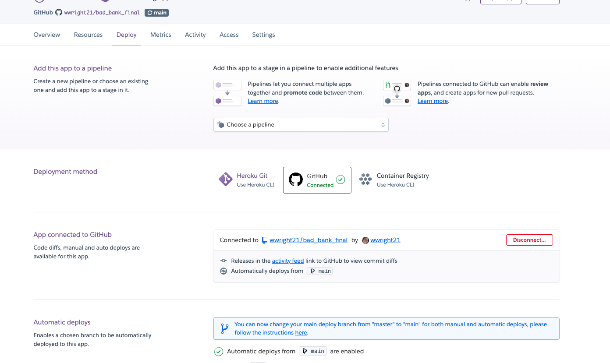
Deployment – Heroku Success

Slide 37
Deployment – Challenges
Docker software update
Initial Heroku deployment didn’t work properly, so had to deploy via CLI

Slide 38
Additional Features
Password visibility toggle

Slide 39
Additional Features
Password visibility toggle
Transaction history

Slide 40
Additional Features
Password visibility toggle
Transaction history
Account type

Slide 41
Additional Features
Password visibility toggle
Transaction history
Account type
Account number / routing number auto generated

Slide 42
Additional Features
Password visibility toggle
Transaction history
Account type
Account number / routing number auto generated
Testimonials

Slide 43
Additional Features

Slide 44
Reflection
To do differently:
Explore React frameworks like Next.js

Slide 45
Reflection
To do differently:
Explore React frameworks like Next.js
Use Google Firebase to handle authentication

Slide 46
Reflection
To do differently:
Explore React frameworks like Next.js
Use Google Firebase to handle authentication
Use charting library like charts.js to show user balance change over time

Slide 47
Demo
Demo time!

